Slide 1
High resolution dynamics of HABs in two Cape Cod ponds
Jeff Hollister, Stephen Shivers, Betty Kreakie, Don Cobb, Sophie Fournier, Laura Erban, Tara Burke

Slide 2
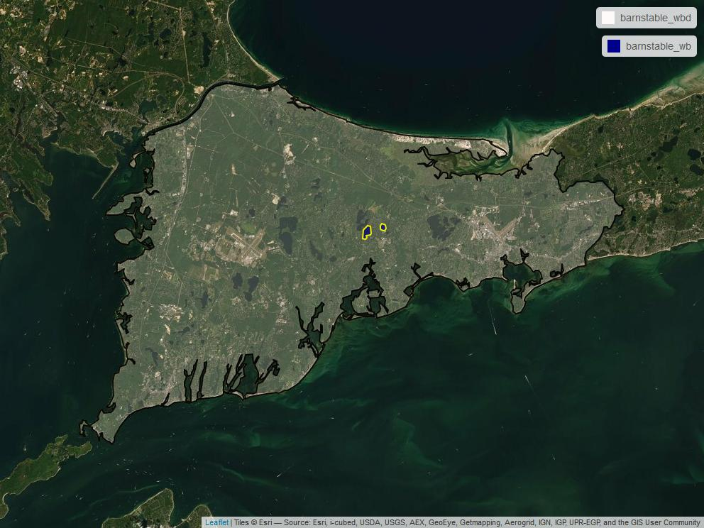
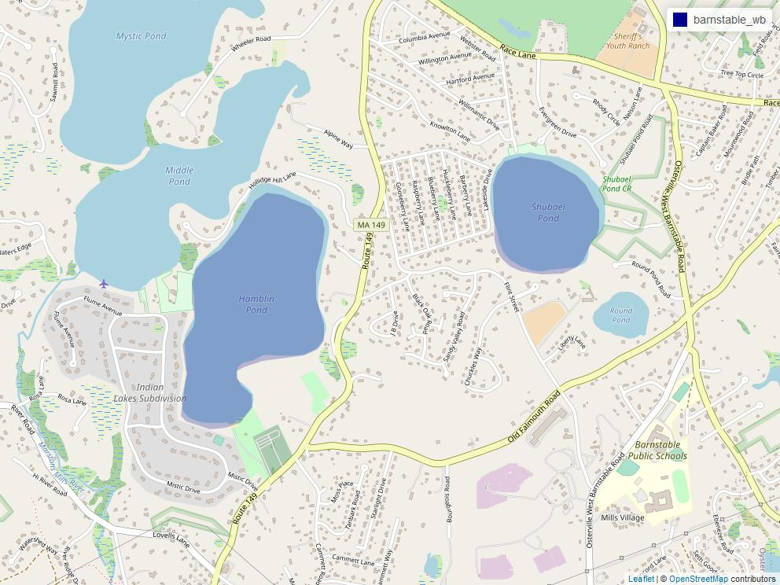
Where, When
Shubael Pond and Hamblin Pond
Compliments SDR d
A-pod deployment?
June to November
Started 2021

Slide 3
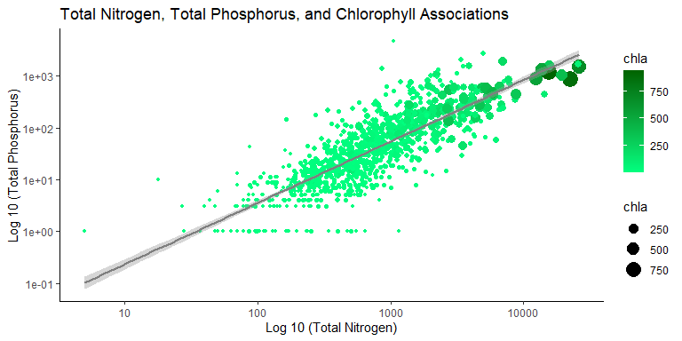
Why High Resolution?
Why High Resolution?
We know the general process (nutrients and temperature)
Don’t know fine scale triggers

Slide 4
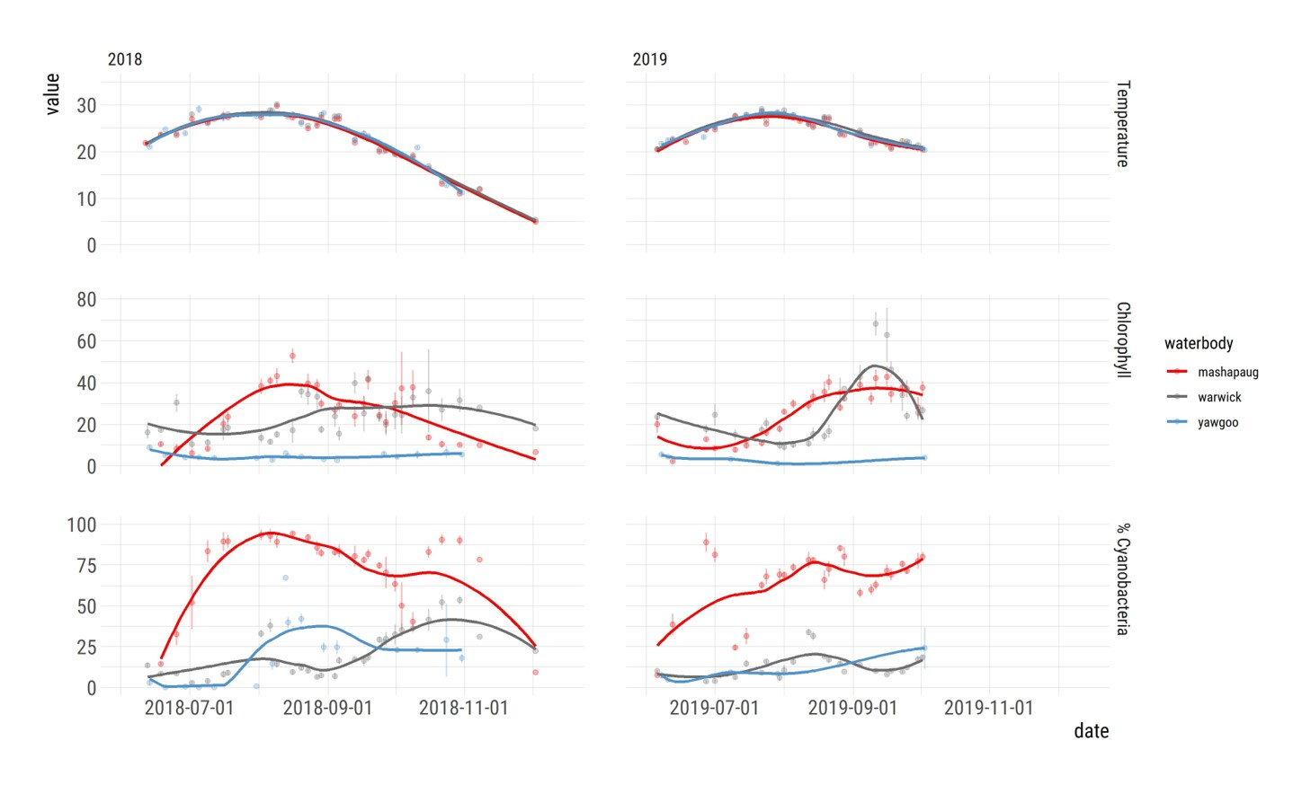
Why High Resolution?
Why High Resolution?
Forecasting requires high resolution
Butitta et al 2017 (3500 points in 2.5 ha/6 acre lake)
Ortiz el al. 2020 (every 15 minutes)
Wilkinson et al. 2018 (every 5 minutes)
Dakos et al. 2012 (1000's of equal time steps)

Slide 5
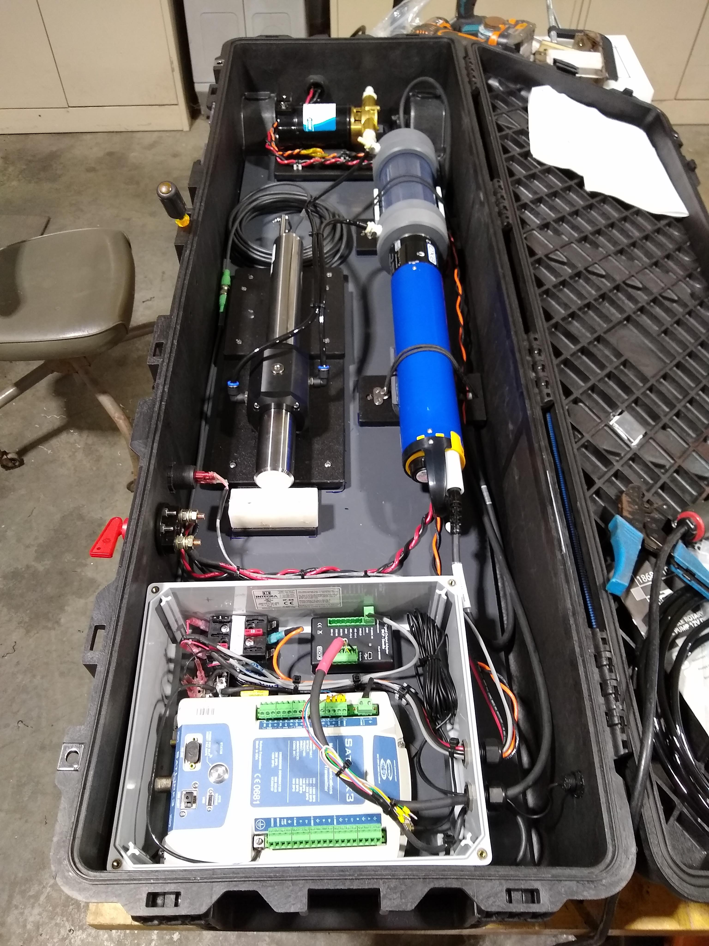
How: HABS over space
Fast Limnological Automated Measurments (FLAMe)
University of Wisconsin Center for Limnology: https://flame.wisc.edu
On-board flow through system
Multiparameter Sonde
Optical nitrate sensor
Measurements approx. every 20 meters
Twice a month
Work in progress!

Slide 6
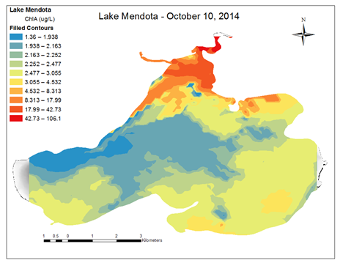

Slide 7
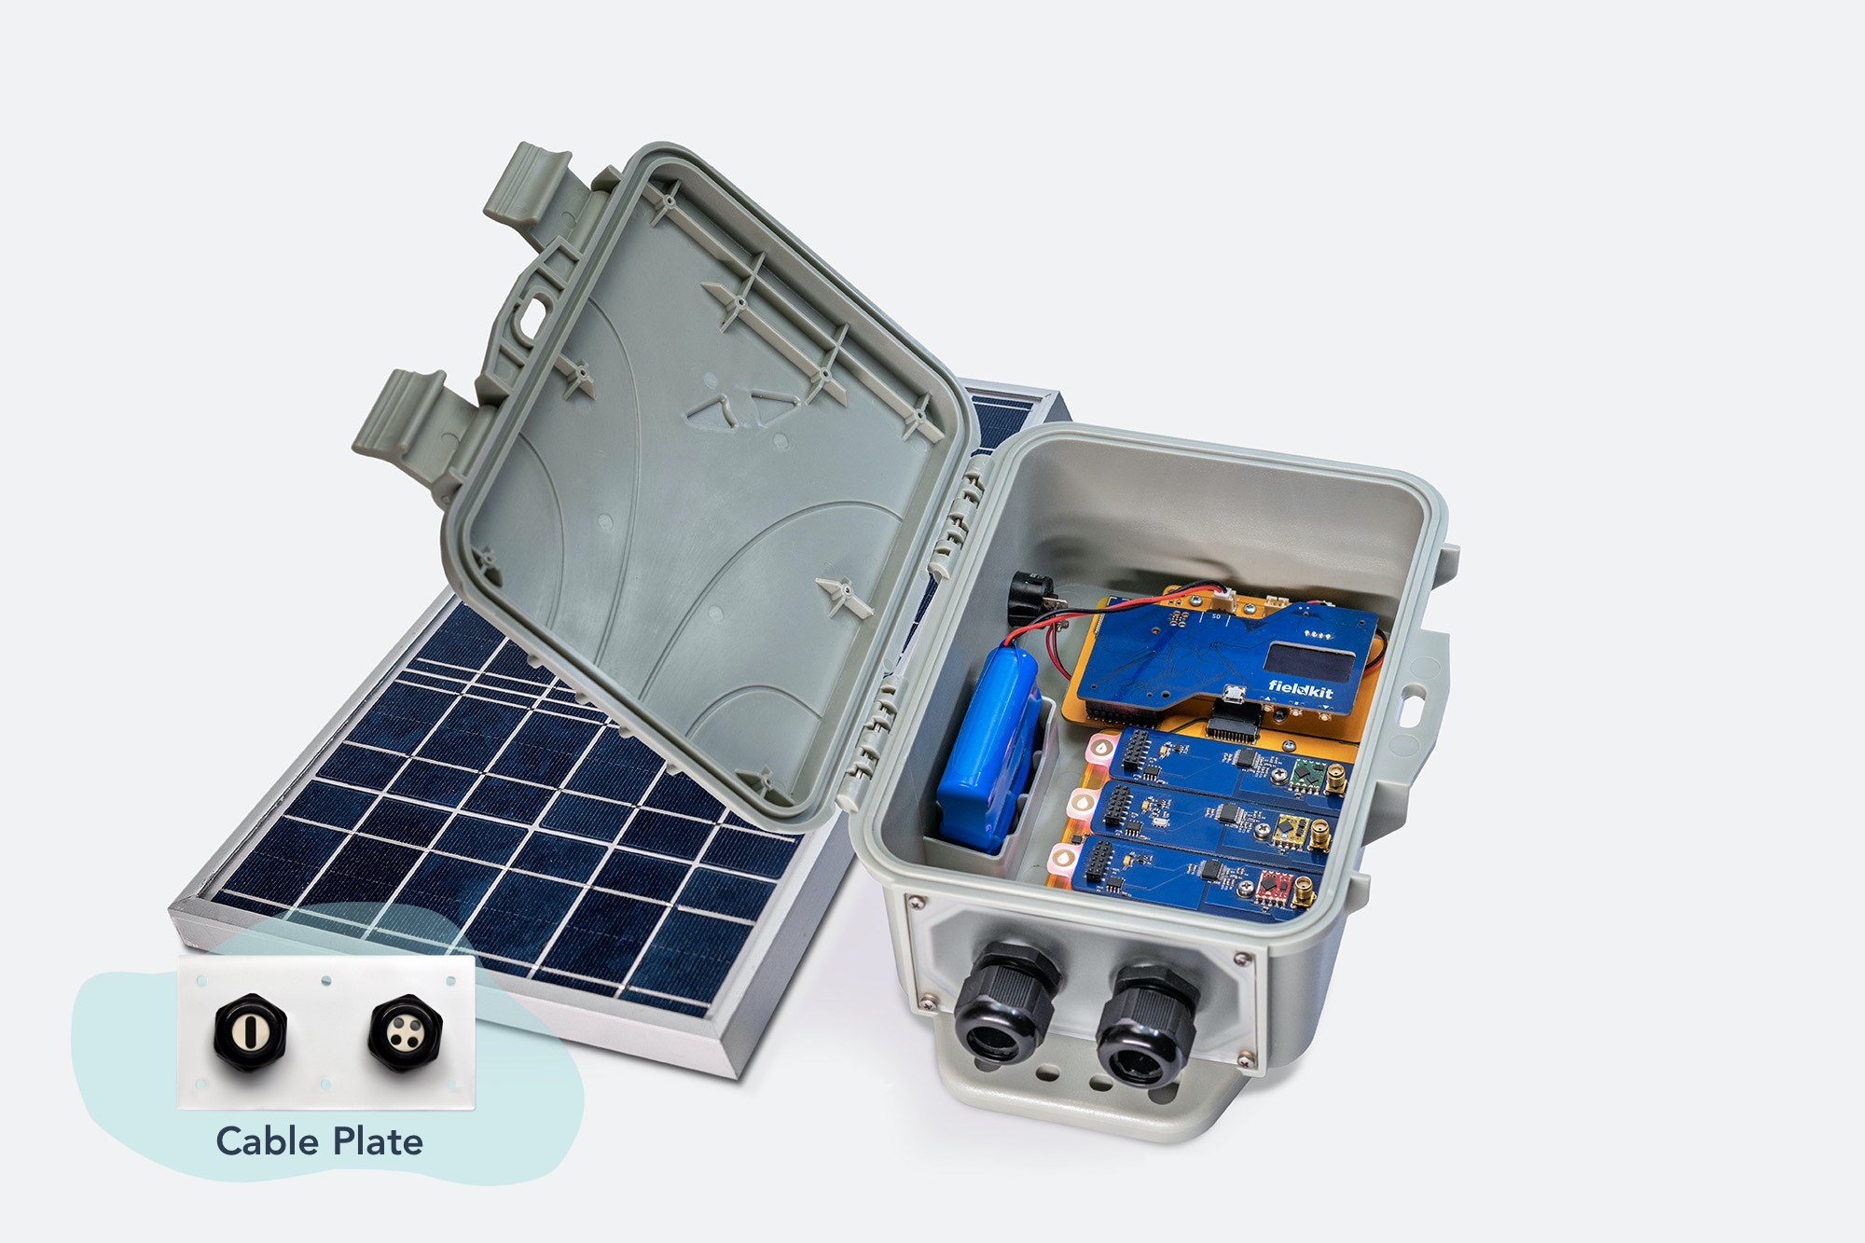
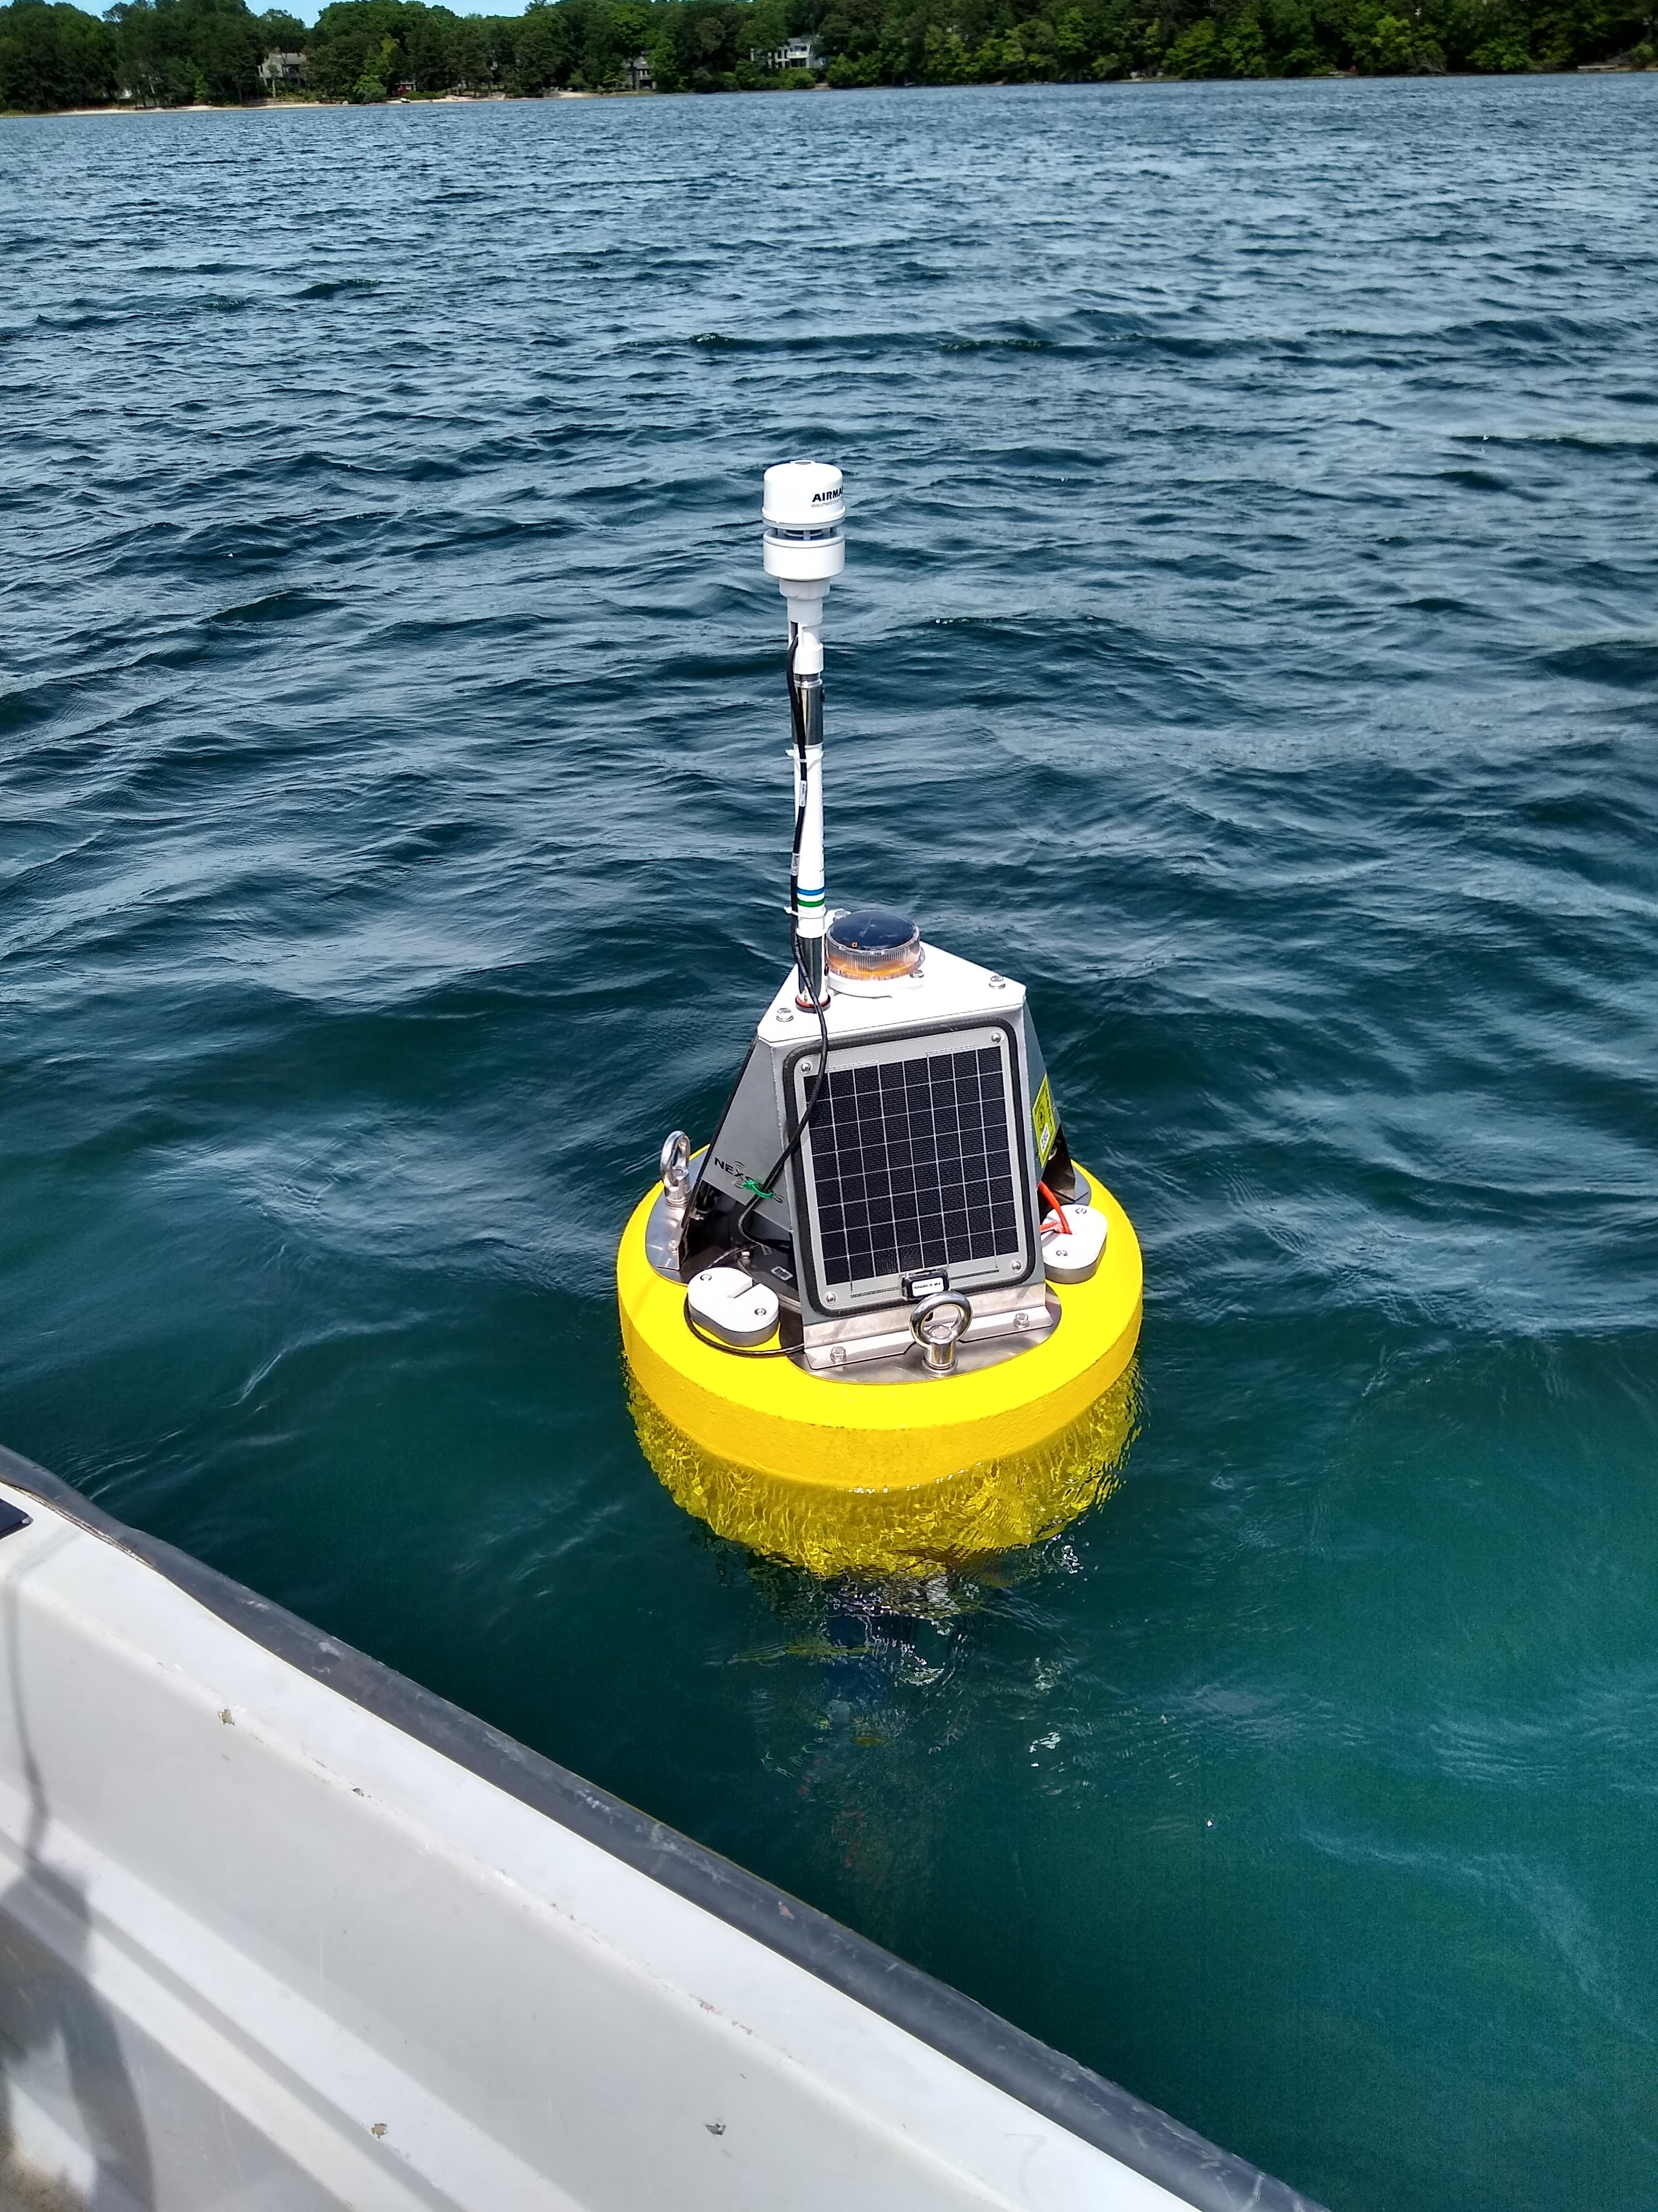
How: HABS over time
Nexsens CB-150 Buoy
Multiparameter sonde
Temperature, dissolved oxygen, pH, conductivity, tubirdity, FDOM, chlorophyll, phycocyanin
Optical nitrate sensor
Weather station
FieldKit Water with solar
Temperature, dissolved oxygen, pH, conductivity
Fixed location
Every 15 minutes

Slide 8
Preliminary Results
Shhhh

Slide 9
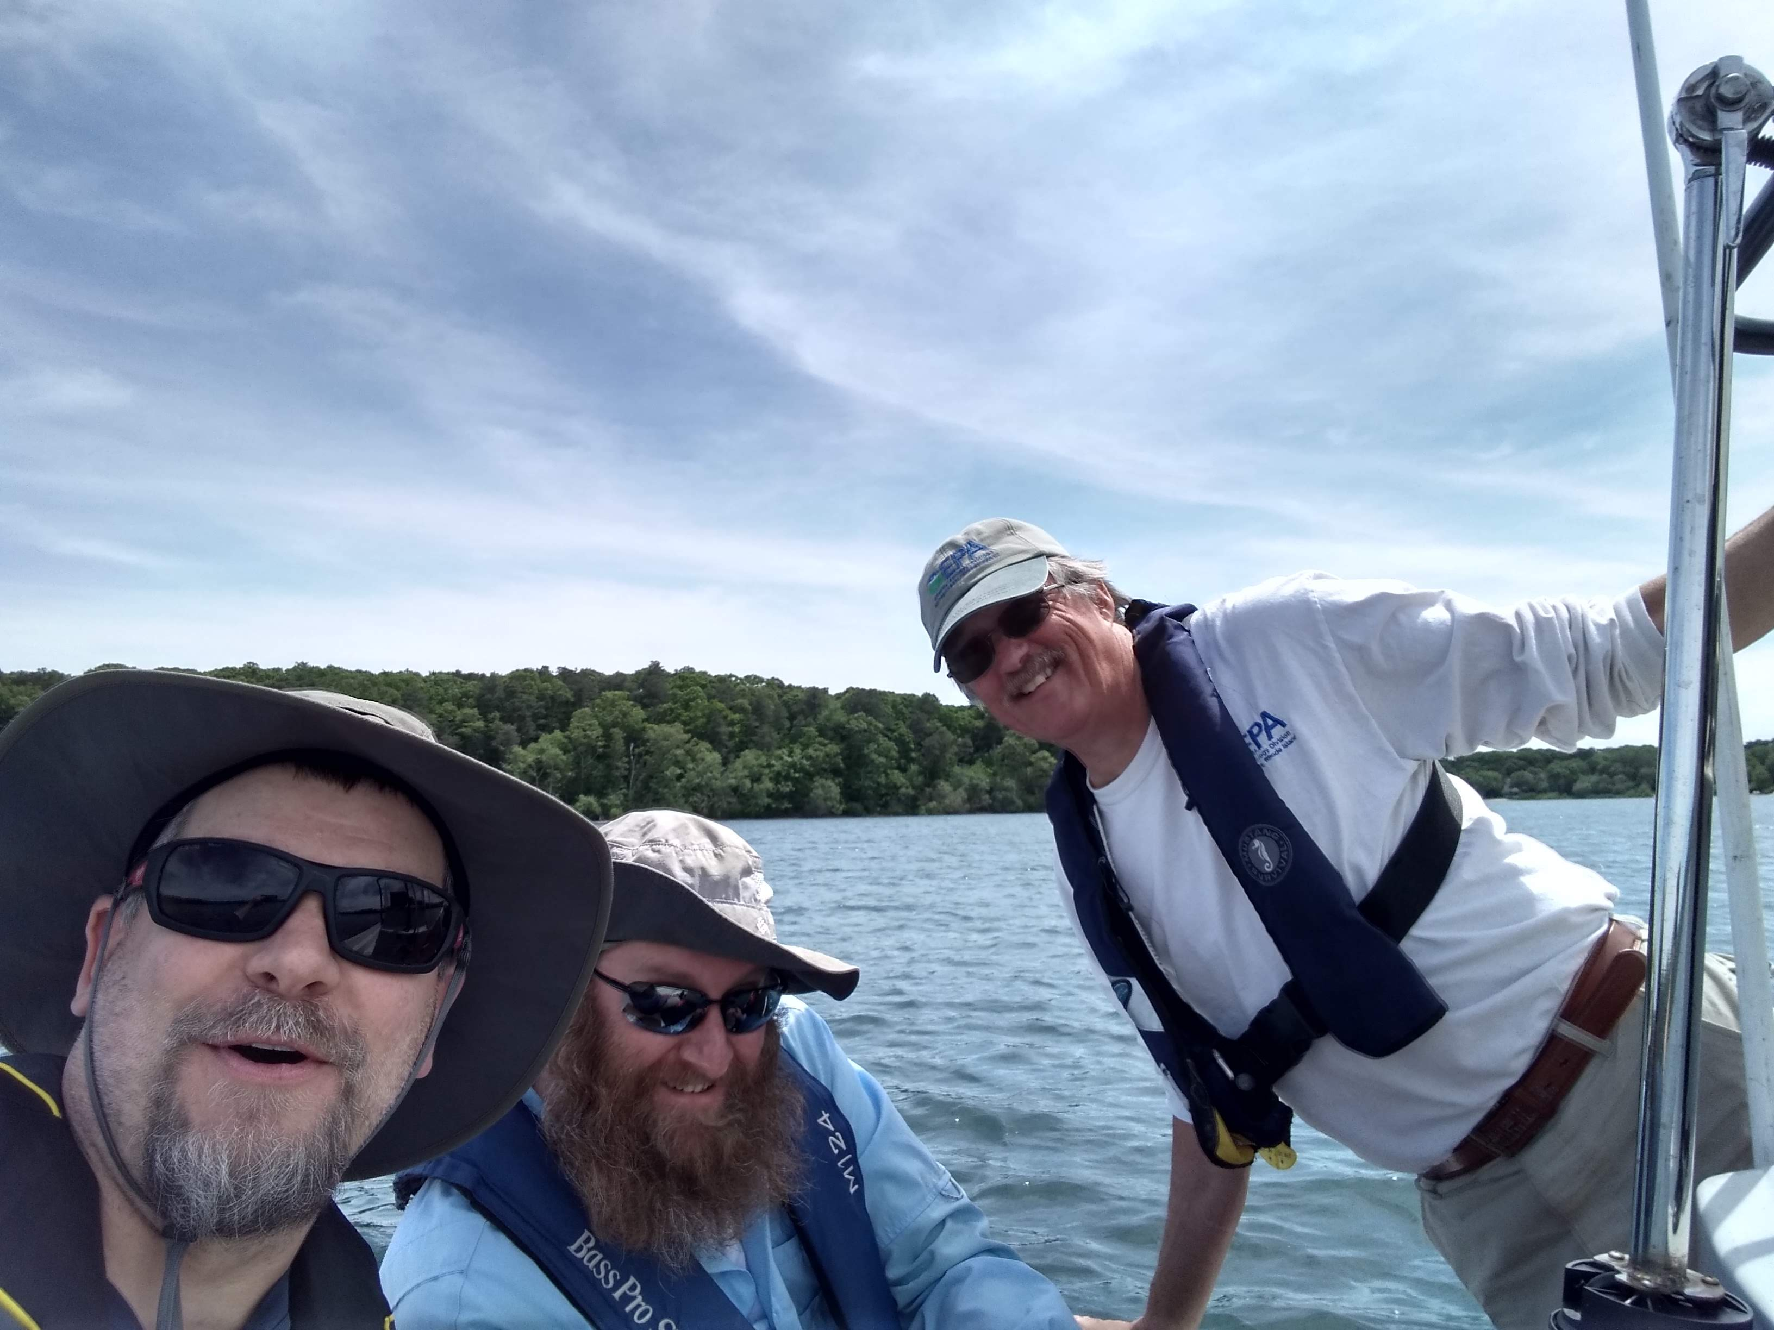
Questions: Happy Field Crew

